Slide 1
Brainstorming and Prototyping
Batch 12, Group D
[18/10/2020]

Slide 2
Today’s Presentation
Introduction
Our Brainstorming Session
Our Idea
Our Prototype
Things We Learned

Slide 3
1. Introduction
Brainstorming and Prototyping

Slide 4
Introduction
This is part of a Design Thinking (DT) project. The DT challenge is to raise the approval rating of the AP state government to 90%.
At first, we will share the details and process about our brainstorming session.
Then we will share our idea and the reasons for this idea to be selected.
After that we are going to present the prototype which we had designed
Finally, we will tell about the things which we have learnt during the assignment discussion.

Slide 5
2. Our Brainstorming Session
Brainstorming and Prototyping

Slide 6
Our Process
Details of your brainstorming process
• We held our brainstorming session on 17th October 2020
•7 members of our group are involved in brain storming
•We used Random Prompts, Counterfactuals, Perspective shifting, Worst idea, Journey to the future
•We got around 20 ideas in our brainstorming session
•We evaluated based on need of people and for 90%approval rating of AP state

Slide 7
Random Prompts
Think of a solution that begins with the letter D?
Drones to keep track on traffic.
Driverless vehicles.
Drivers with professional training.
What solution do you think of when you read the word “Accidents”?
Sensors in vehicles that alert in case of accidents
Vehicle starts by detecting alcohol percent in the driver

Slide 8
Counterfactuals (Imaginary World)
Flying Vehicles
Holography concept at zebra crossing
Worst Ideas
Decreasing traffic Signals
Increasing traffic signals
Uneven roads
Even roads

Slide 9

Journey to the Future
Robots for traffic control
Driverless cars
Flying cars
Perspective Shifting
Highlighting accident prone areas in Google Maps.
Google assistant (or Siri) that warns when speed limit increases while driving

Slide 10
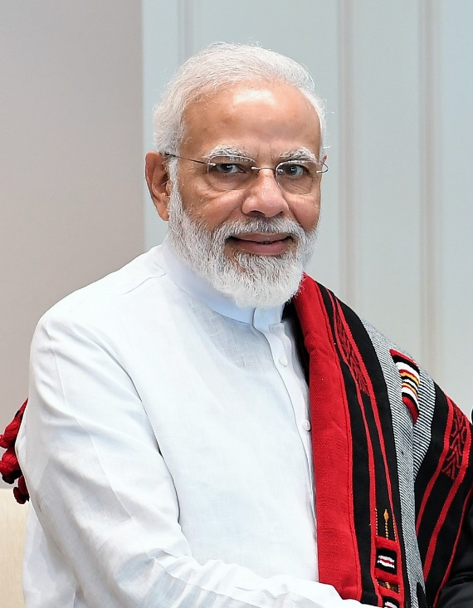
Perspective Shifting
Increasing lanes on the highways
Increasing fly Overs
Strict laws on traffic rules violation

Slide 11

3. Our Idea
Brainstorming and Prototyping

Slide 12
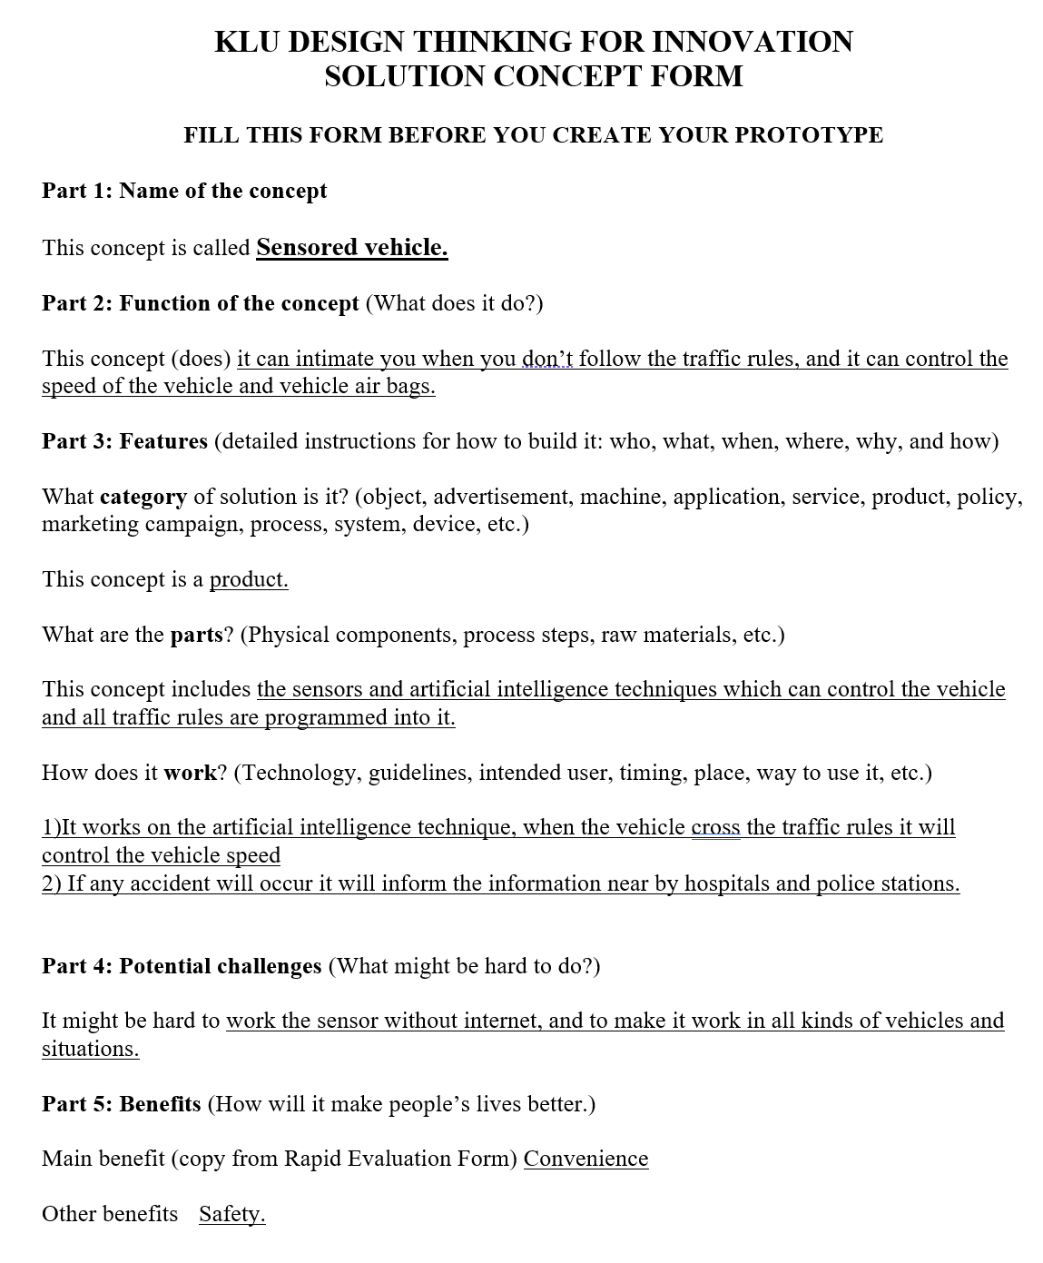
Our Selected Idea
Sensored vehicle

Slide 13
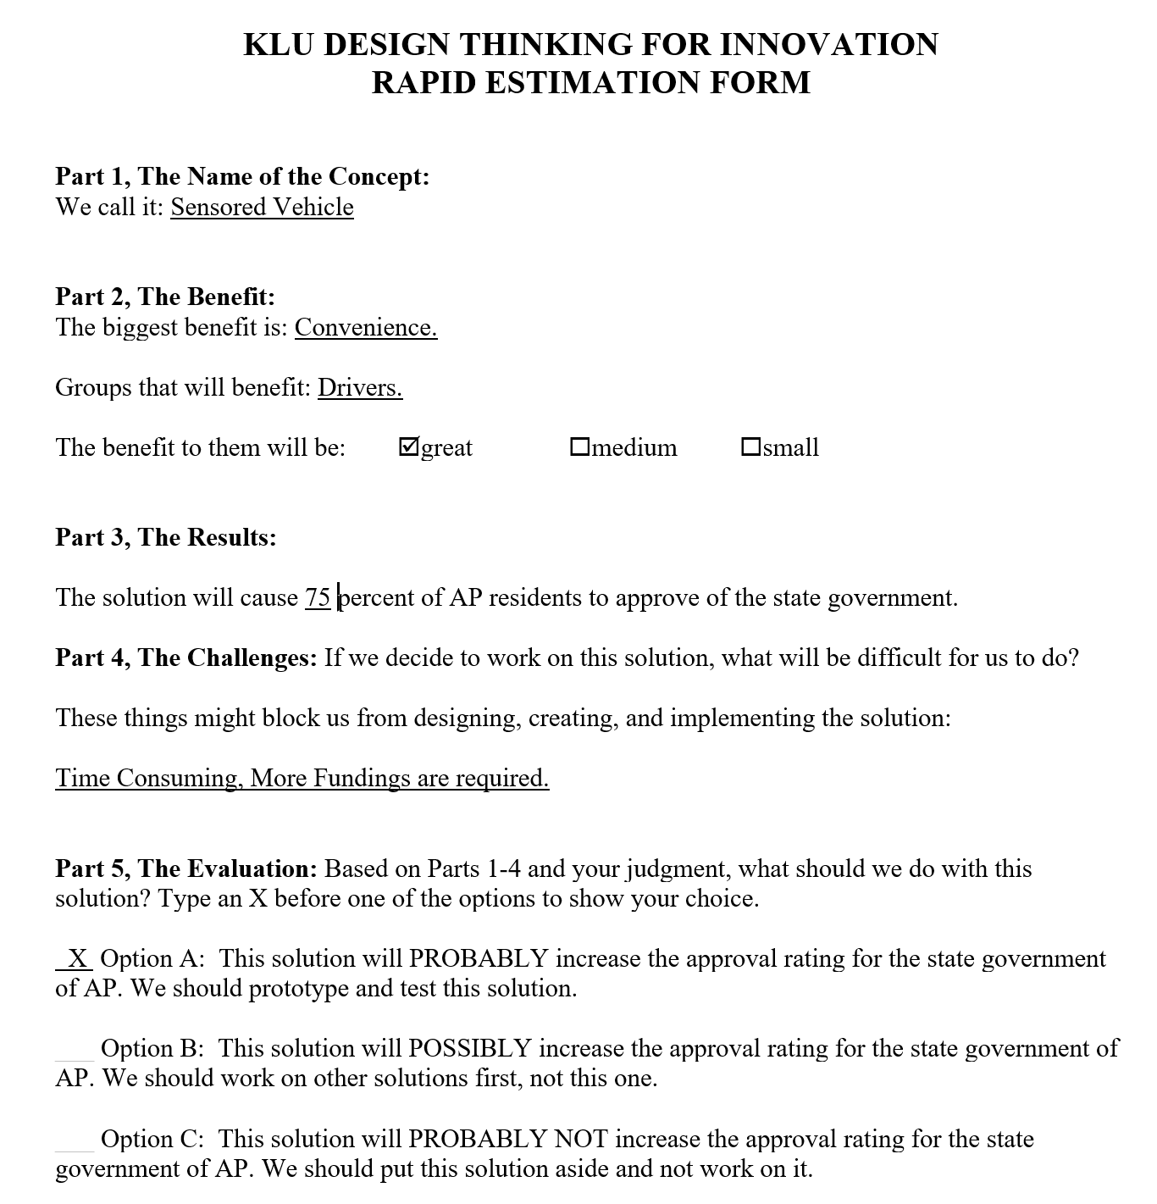
Our Justification
We think it is our Best idea because
Basis in evidence.
Largest market size
Fewest copyright/patent issues

Slide 14
4. Our Prototype
Brainstorming and Prototyping

Slide 15
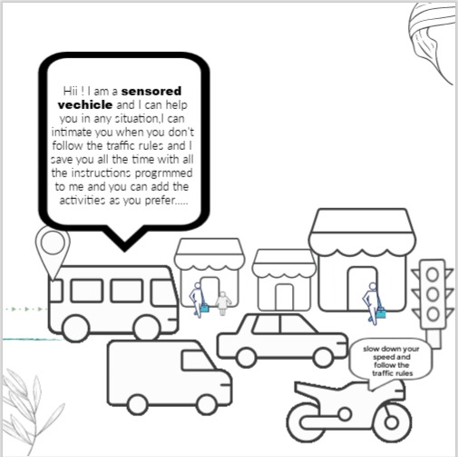
Our Concept Prototype
Group member drew it -- Yamini
Group member gave ideas -- Sidhardh
Alerts when speed is above the limit - Convenience/Safety

Slide 16
5. Things We Learned
Brainstorming and Prototyping

Slide 17
Lessons Learned
We discussed the importance of safety and safety devices .
Knew about the present technologies using in automobiles.
Got knowledge in using the technologies for new innovations.
Due to Brain storming and Prototype, we got the confidence that we can develop the new products required for the people regarding safety on roads.

Slide 18
Thank You…! 👍
From Batch – 12 Project – D

